Slide 1
Image Annotation
Manual Image Annotation for Machine Learning
Ellie, Robbie & Nina (Missing ‘M’ for MERN.... 😭)

Slide 2
Image Annotation

Slide 3
Computer Vision
Wiki:
“Computer vision is an interdisciplinary field that deals with how computers can be made to gain high-level understanding from digital images or videos.”

Slide 4
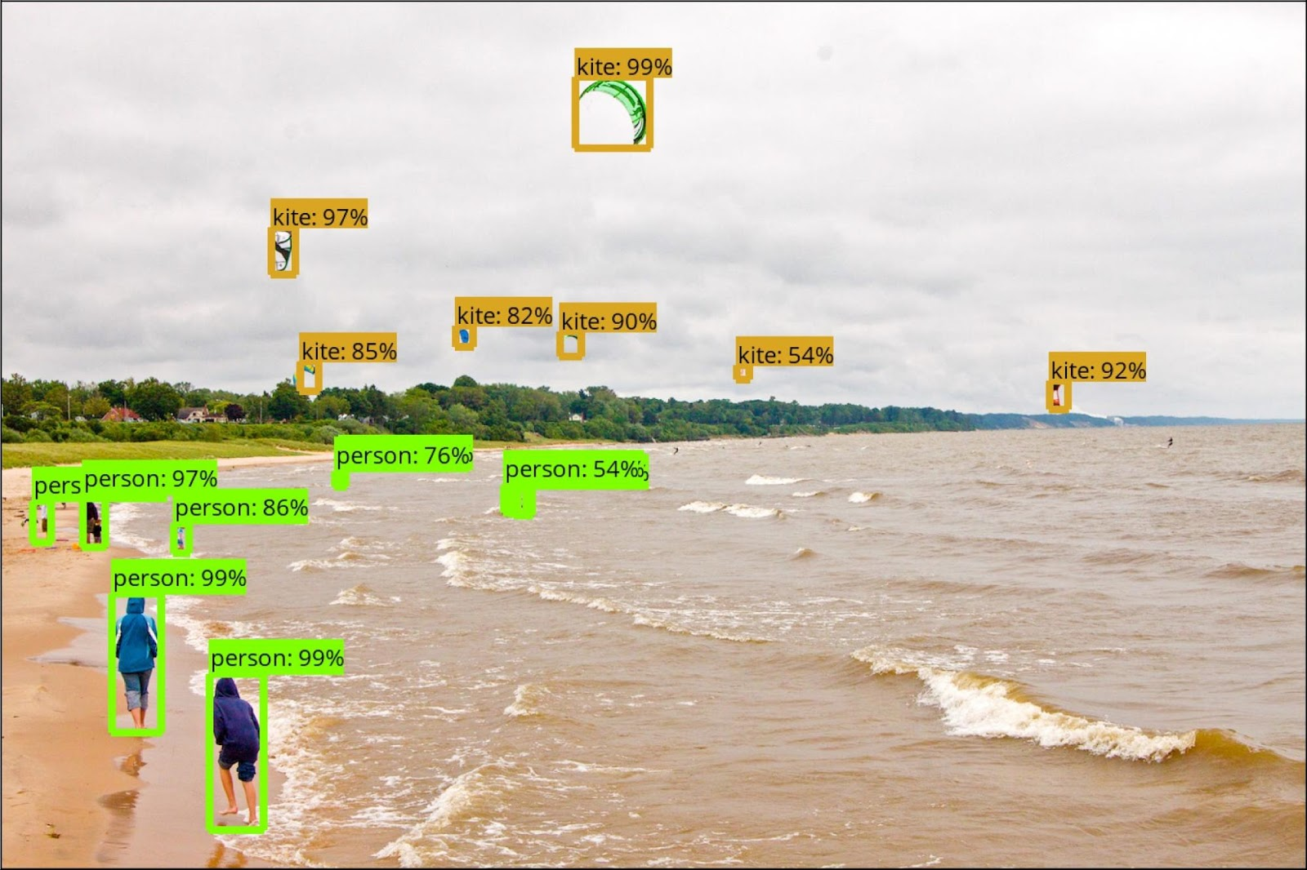
Object Detection
Notes:
Image: https://ai.googleblog.com/2017/06/supercharge-your-computer-vision-models.html

Slide 5
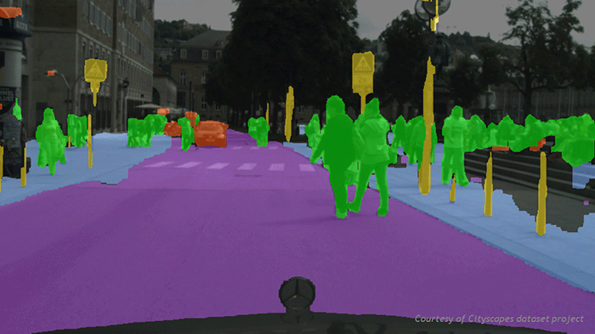
Autonomous driving
Notes:
Image: https://blogs.nvidia.com/blog/2016/01/05/eyes-on-the-road-how-autonomous-cars-understand-what-theyre-seeing/

Slide 6
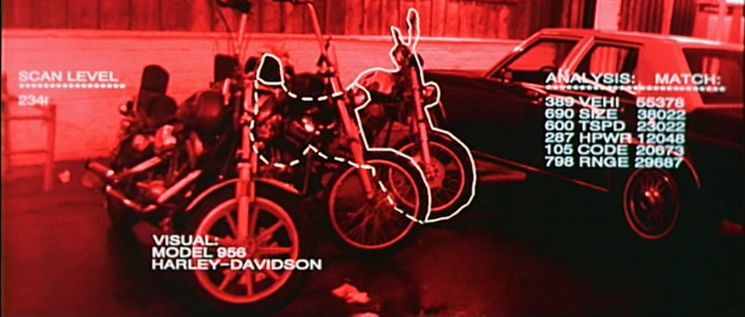
Pop culture
Notes:
Image: https://medium.com/@julsimon/gluon-cv-add-image-classification-detection-and-segmentation-to-your-application-in-minutes-1dbf6389acc5

Slide 7
Machine Learning
Powers many Computer Vision solutions
Needs excessive amount of data for training
The data is usually generated by people => Manual Image Annotation

Slide 8
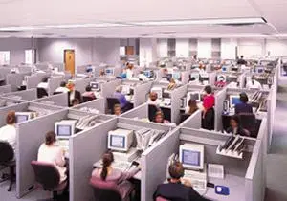
Manual Image Annotation
Humans look into images and find areas of interest
Notes:
Image: https://bryanchain.com/2008/06/12/whats-so-bad-about-cubicles/
Image: http://www.robots.ox.ac.uk/~vgg/blog/vgg-image-annotator.html

Slide 9
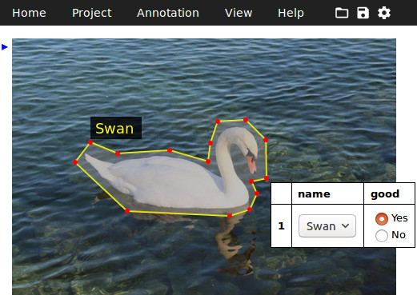
Manual Image Annotation
Humans look into images and find areas of interest
Then they mark these areas with tags
Notes:
Image: https://bryanchain.com/2008/06/12/whats-so-bad-about-cubicles/
Image: http://www.robots.ox.ac.uk/~vgg/blog/vgg-image-annotator.html

Slide 10
Manual Image Annotation
Humans look into images and find areas of interest
Then they mark these areas with tags
Then the data is loaded into ML pipeline
ML pipeline uses the images for training
Notes:
Image: https://bryanchain.com/2008/06/12/whats-so-bad-about-cubicles/
Image: http://www.robots.ox.ac.uk/~vgg/blog/vgg-image-annotator.html

Slide 11

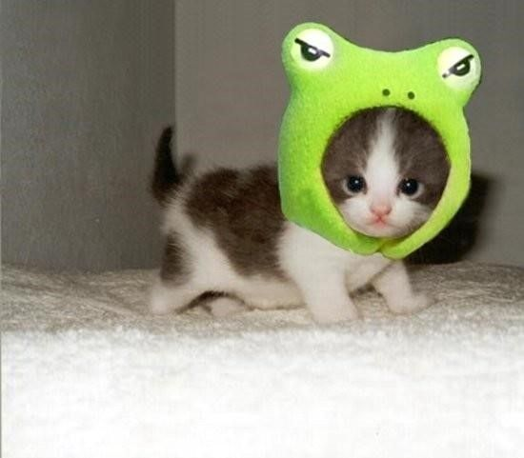

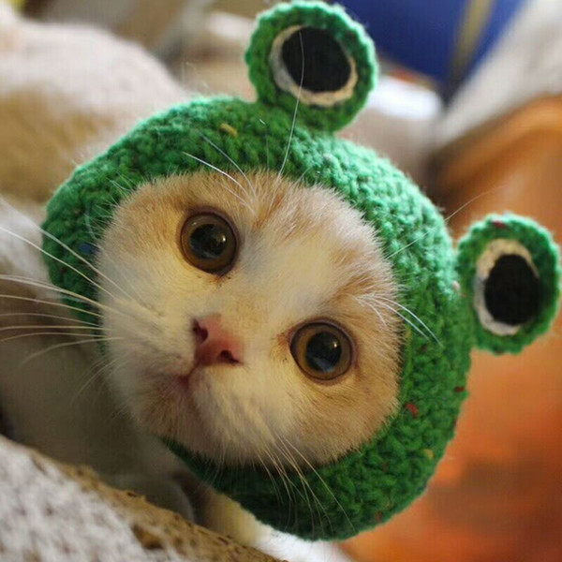
Manual Image Annotation Process
Cat
(0.1; 0.3)
(0.7; 0.6)
Frog Hat
(0.3; 0.3)
(0.6; 0.35)
Cat
(0.1; 0.3)
(0.7; 0.6)
Frog Hat
(0.3; 0.3)
(0.6; 0.35)
Cat
(0.1; 0.3)
(0.7; 0.6)
Frog Hat
(0.3; 0.3)
(0.6; 0.35)
Notes:
Image: https://cutecatsinhats.com/frog-hat-cat/
Image: https://www.dhgate.com/product/hot-sale-hand-knitted-pet-hats-frog-cat-hat/462972171.html#seo=WAP
Image: https://www.pinterest.com.au/pin/172825704420035388/

Slide 12
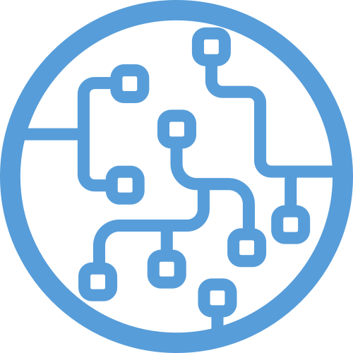
Machine Learning Pipeline
Cat
(0.1; 0.3)
(0.7; 0.6)
Frog Hat
(0.3; 0.3)
(0.6; 0.35)
0.1, 0.3, 0.7, 0.6, 0.75, 0.80
Cat
(0.1; 0.3)
(0.7; 0.6)
Frog Hat
(0.3; 0.3)
(0.6; 0.35)
0.2, 0.4, 0.7, 0.6, 0.35, 0.80
0.1, 0.7, 0.7, 0.6, 0.76, 0.80
0.1, 0.01, 0.7, 0.6, 0.75, 0.32
0.0, 0.35, 0.7, 0.6, 0.75, 0.2
0.1, 0.3, 0.17, 0.6, 0.5, 0.001
Cat
(0.1; 0.3)
(0.7; 0.6)
Frog Hat
(0.3; 0.3)
(0.6; 0.35)
…
A LOT!
Notes:
Image: https://cutecatsinhats.com/frog-hat-cat/
Image: https://www.dhgate.com/product/hot-sale-hand-knitted-pet-hats-frog-cat-hat/462972171.html#seo=WAP
Image: https://www.pinterest.com.au/pin/172825704420035388/
ML Pipeline takes annotation results and converts it into arrays of numbers. Then these arrays are used to train a model.

Slide 13
Manual Image Annotation Process
Cat
(0.1; 0.3)
(0.7; 0.6)
Frog Hat
(0.3; 0.3)
(0.6; 0.35)
Our Tool
Cat
(0.1; 0.3)
(0.7; 0.6)
Frog Hat
(0.3; 0.3)
(0.6; 0.35)
Cat
(0.1; 0.3)
(0.7; 0.6)
Frog Hat
(0.3; 0.3)
(0.6; 0.35)
Notes:
Image: https://cutecatsinhats.com/frog-hat-cat/
Image: https://www.dhgate.com/product/hot-sale-hand-knitted-pet-hats-frog-cat-hat/462972171.html#seo=WAP
Image: https://www.pinterest.com.au/pin/172825704420035388/

Slide 14
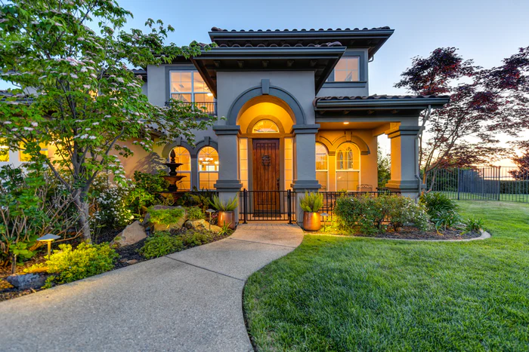
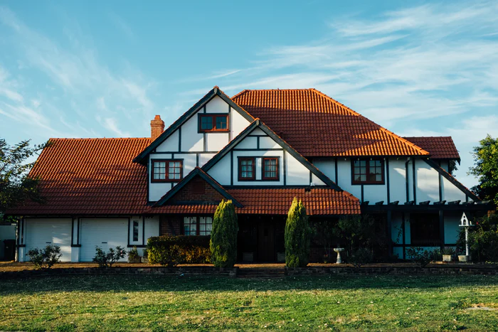
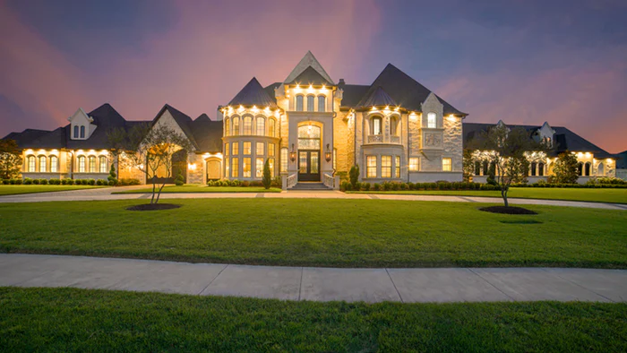
Real Estate Price Evaluation
$360,000
$480,000
???
Notes:
Images from unsplash.com
The first application is property price evaluation.

Slide 15
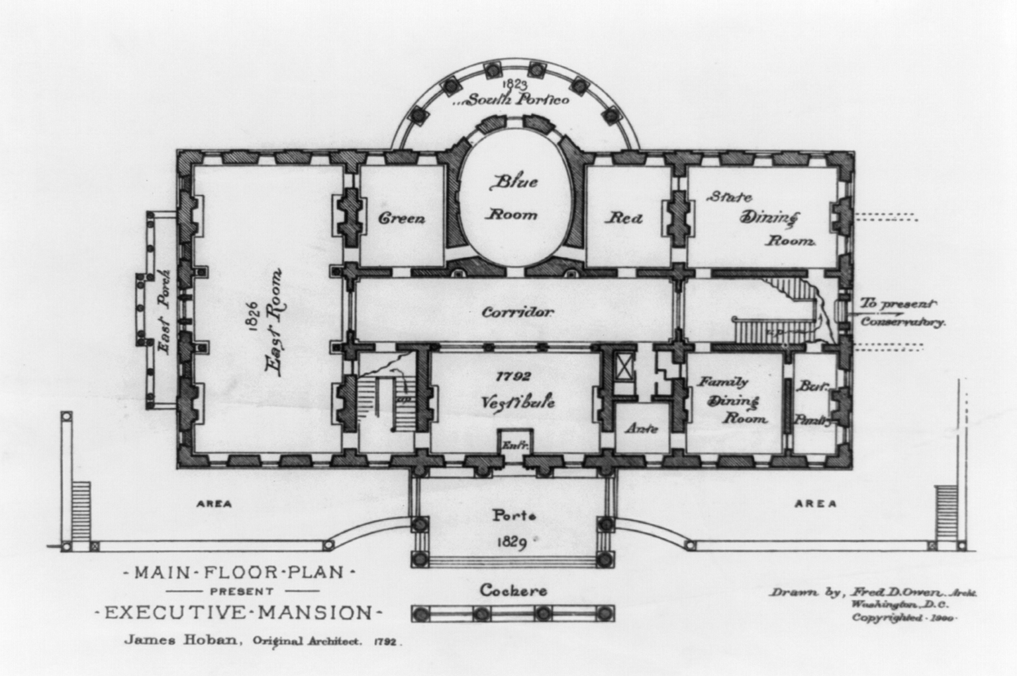
Property Plan Annotation
$480,000
Notes:
Image: https://commons.wikimedia.org/wiki/File:State_floor_plan_-_White_House_-_1900.jpg

Slide 16
Our Project

Slide 17
Goal
Effortless and Accurate manual image annotation

Slide 18
Goal
Effortless and Accurate manual image annotation
Effortless - task management features

Slide 19
Goal
Effortless and Accurate manual image annotation
Effortless - task management features
Accurate - image annotation, review and cross-validation features

Slide 20
Core Features
1. Image Annotation
2. Tag Management and Search
3. Role-based authentication
4. Annotation Review
5. Image Flow Management (e.g. Project->Building->Floor).
6. Image Metadata Management
7. Image Navigation

Slide 21
MVP
1. Image Annotation
2. Tag Management and Search
3. Role-based authentication (Admin and User only, hardcoded, no ACLs)
4. Annotation Review
5. Image Flow Management (e.g. Project->Building->Floor).
6. Image Metadata Management (Hardcoded)
7. Image Navigation

Slide 22
High Level Design
Browser
Heroku
Frontend (React.js)
Backend (Node.js)
Atlas
MongoDB
Auth
Auth
User
Users
Admin
Projects
Tags
User
Images
Annotations
AWS S3
React Component
API

Slide 23
Main user scenario
Admin
Sign Up
Mark newly created user as Admin in DB
Sign In as admin
Upload Image
Assign Image to a user
Review Image
User
Sign Up
Log In
Annotate Image
Submit for Review

Slide 24
S3 integration
Supports:
Manual file upload (one or more files are uploaded using a form on the website)
Programmatic Batch upload (a large number of images are uploaded to S3 bucket, then all of them are added to the system using single API call)

Slide 25
Data Format
Each Image can have one or more annotations
Each Annotation consists of a list of Marks.
Each Mark consists of a Tag and a list of Coordinates.
This approach gives flexibility to store very simple one-point Marks or very complex shapes (Like Swan).
Each coordinate is normalized (between 0 and 1), so we don’t need to think about image size.

Slide 26
Image Annotation Component
Subcomponents:
Canvas - generates an image with the data (apartment plan with tags over it), passes events when the user clicks on the Canvas.
Tags - allows to select a tag that the user wants to put on Canvas. If nothing is selected, the clicks over the Canvas are discarded.
Marks - allow to remove already set marks.
Things get complicated when we need to take into account Review process, e.g. Image Annotation is locked for images in review or after approval

Slide 27
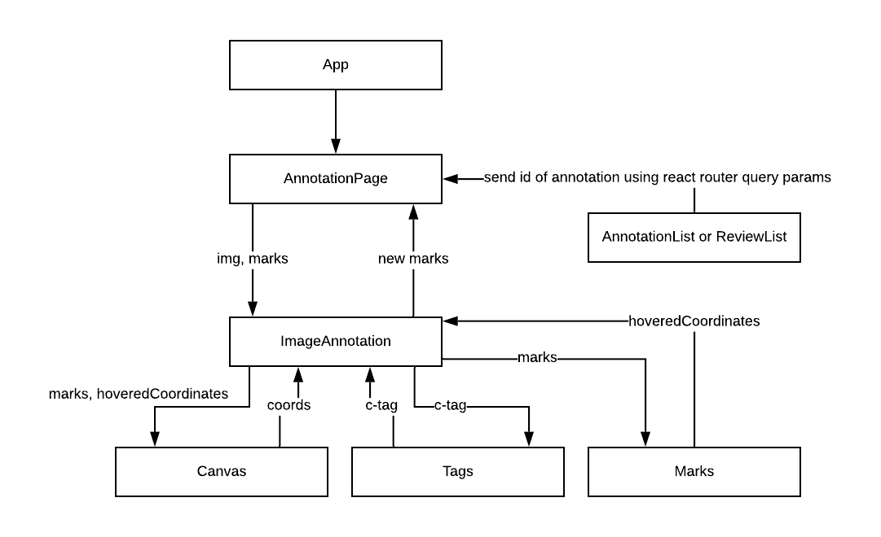
Image Annotation Component Architecture
Notes:
we have app which includes annnotation page which passes ….to imageAnnota
current selected tag

Slide 28
React + Canvas
Wooops, it worked!
To use Canvas in React:
On Render create empty Canvas (return <canvas> JSX)
React will create the DOM Element(for canvas) and put it into Document.
On ComponentDidUpdate we find our Canvas in DOM and draw in it.
Finding the DOM element requires React references.

Slide 29

Redux
Notes:
React has isolated well-controlled state.
Redux flattens it and opens a door to every component that wants to break it.
I don’t get how Actions help, because we still pass value that will overwrite the state.

Slide 30
Lessons Learned

Slide 31

Speed of light is so low
UI became very slow when we decided to make an API call for saving each mark
Notes:
When developing locally there is no network delay. Things look completely different when we deploy to a free-tier virtual machine.

Slide 32

Navigating Ambiguity
DESIGN DOC
Notes:
Image: https://knowyourmeme.com/memes/i-have-no-idea-what-im-doing
Had to learn a lot, design doc and documentation we started with became useless quickly, we should have started with a napkin drawing and get to a MVP as soon as possible.

Slide 33
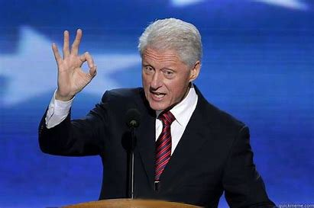
Testing
Use In-Memory Mongoose for integration tests.
ZERO
IS MY TEST COVERAGE

Slide 34
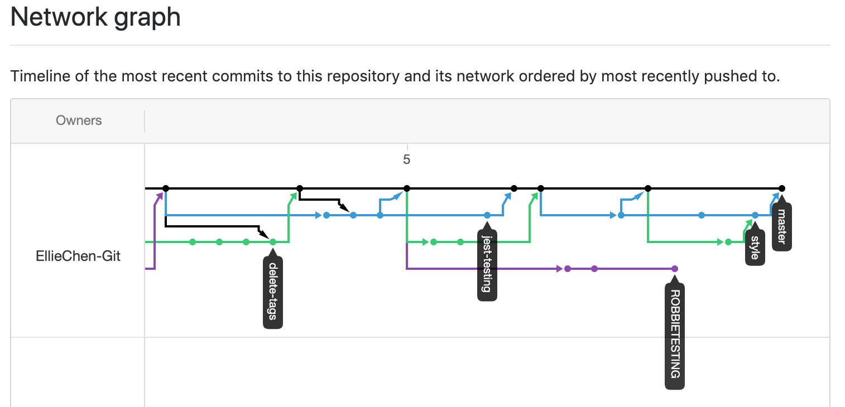
Code Review
Super-awesome, the greatest things since sliced bread.

Slide 35
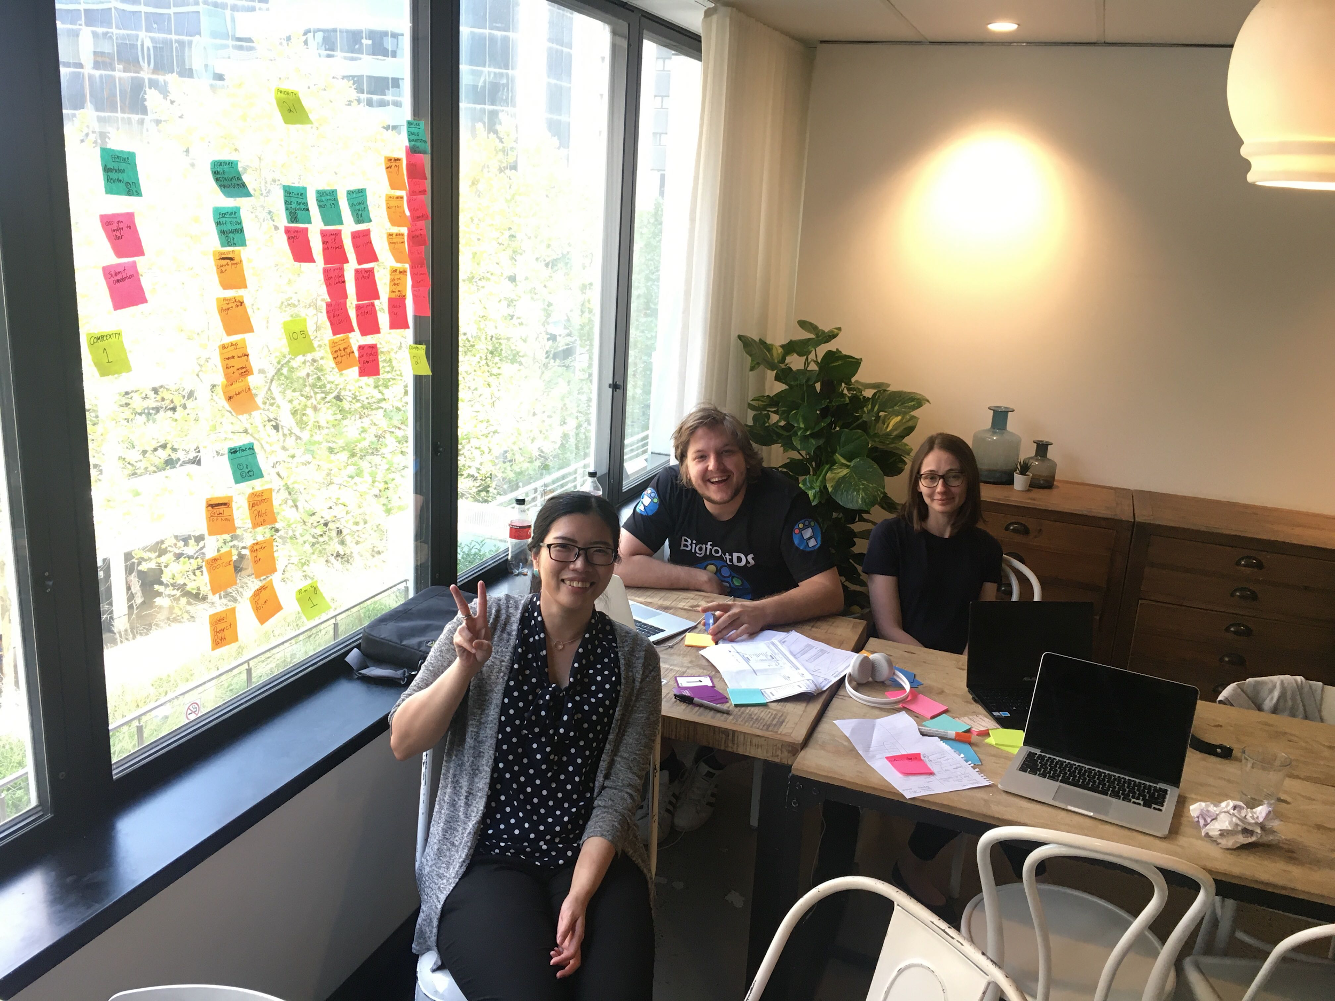
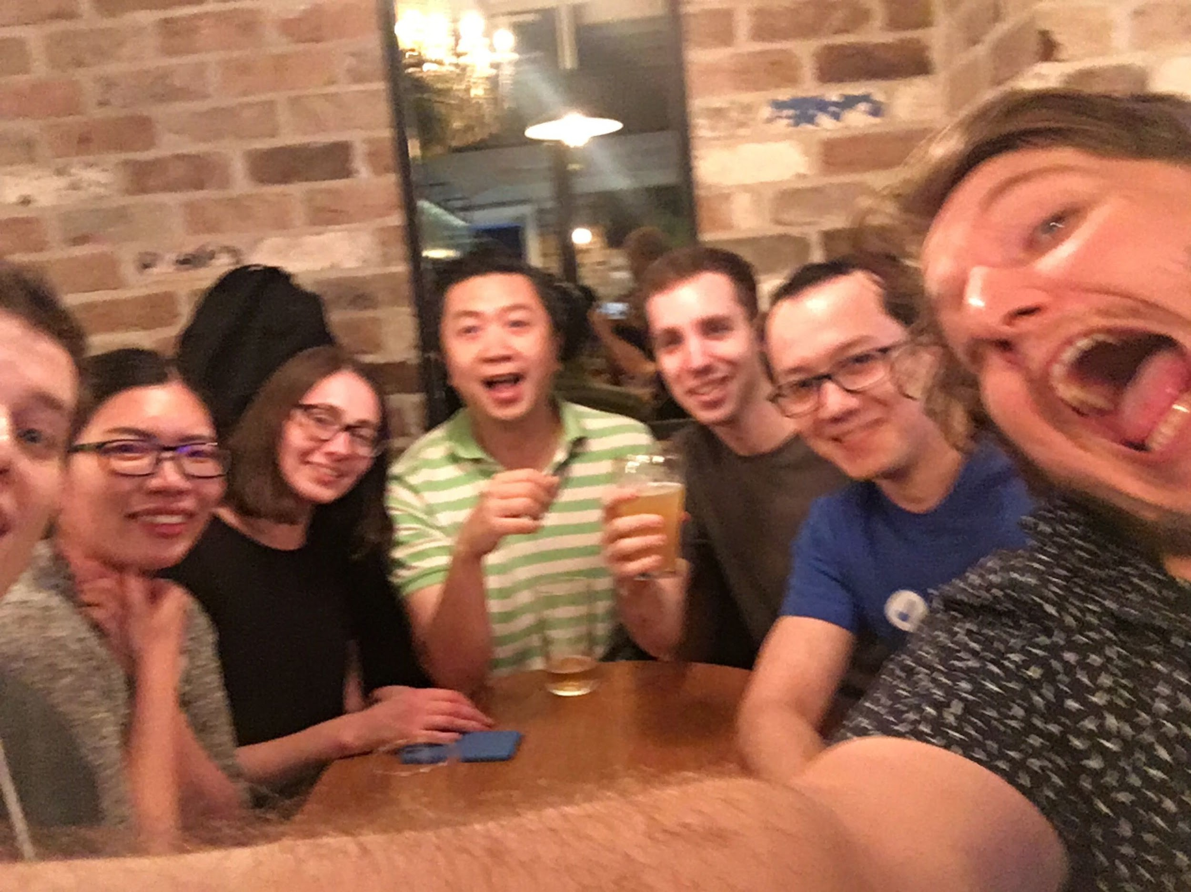
Team work
Each of us contributed a lot
We learned from each other both technical and soft skills
We had fun!

Slide 36
DEMO

Slide 37
FROM OUR CLIENT

